Slide 1
infovis project - group 2 - 2024 final presentation
Global wind power educational dashboard
Jorrit Vander Mynsbrugge
Ruth Vandeputte
Mishkat Haider Chowdhury
Notes:
Ruth
indicate that we also have open questions during our presentations which we want to discuss with beat / yoshi after the presentation

Slide 2



team presentation: group 2
Notes:
Ruth

Slide 3
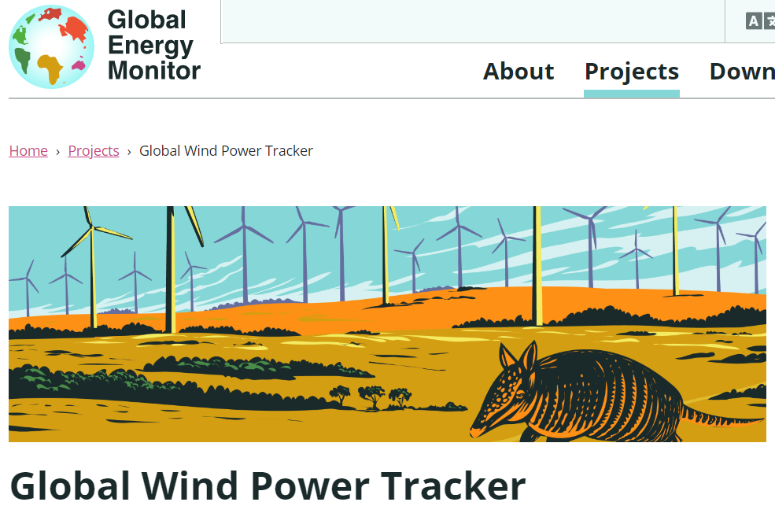
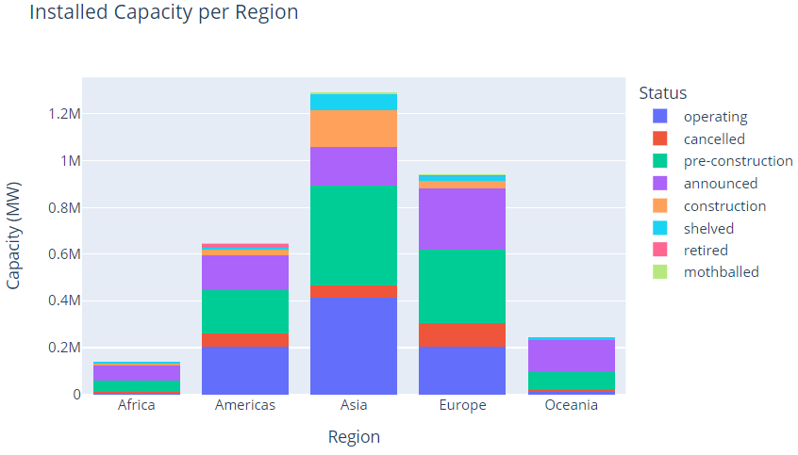
The dataset
27.422 wind farm phases
155 countries
Latest release from December 2023
29 attributes: installation type, status, capacity, coordinates, start year…

Slide 4
The target task(s)
do Q4 in live demo
quickly describe / repeat the target tasks that can be solved with our current app
how is offshore currently distributed over the different continents?
in future years, will the world invest more in onshore/offshore wind
get the top 20 largest operating wind farms in india which are commisioned between 2010 and 2020
can you find me the 3rd largest onshore wind farm of south africa and give me its capacity value?

Slide 5
Changes since last time
data quality improvements (ETL)
linking dashboard components (filters, map, bar chart) trough callbacks
semantic zooming (clustering)
visual tweaks (viewport, contrast, legend placement...)

Slide 6
LIVE DEMO

Slide 7
Evaluation framework
we each look for 1 person to take the test and put the results
we do this by monday evening

Slide 8
Evaluation takeaways
re-evaluate wednesday team call
after analysis

Slide 9
The dataset – missing data
No missing values in key attributes:
Capacity (MW)
Country & Region
Latitude & Longitude
36% of records do not have data for ‘Start year’
Including operational project phases (44GW, 1000+ wind farms)
Adds extra difficulty for time filtering
Need for consensus in handling of incomplete records
try to do start year imputation
if that fails remove records
do not make vis ambiguous (some viz with all data, some with only subset)
Attribute | Number of NaNs
Retired year | 27156
City | 15172
Operator | 10210
Start year | 9919
Owner | 7345
State/Province | 4719

Slide 10
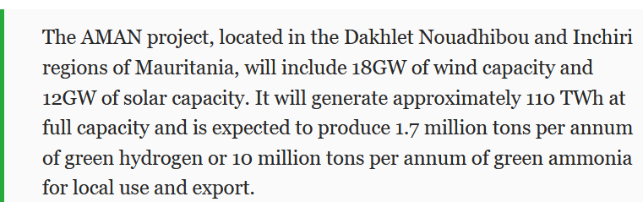
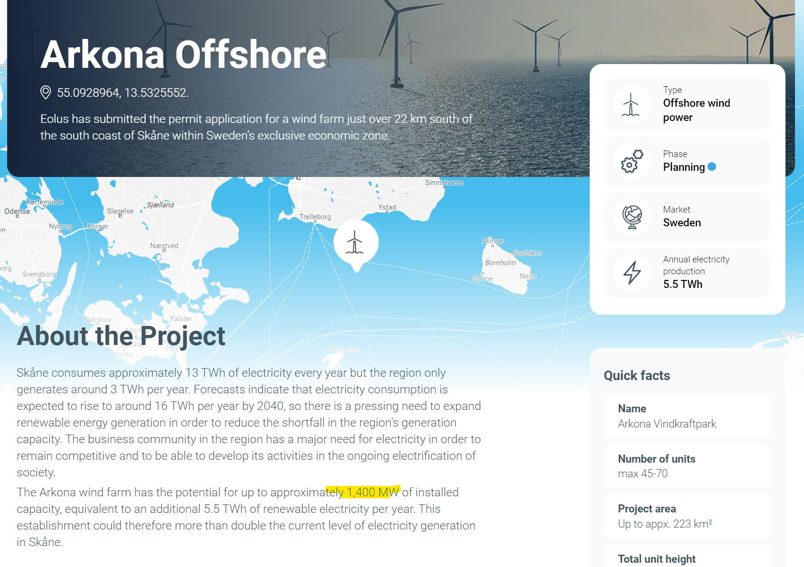
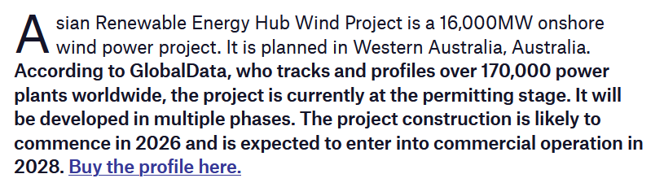
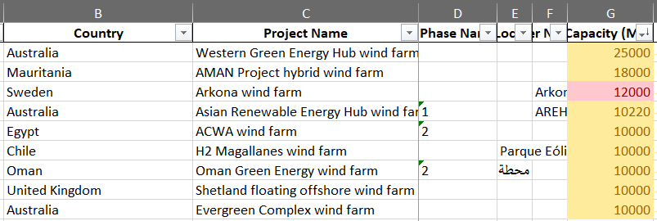
The dataset – quality issues
how was this discovered?
through domain expertise
Sample crosscheck done both on operating & announced projects
Issue with capacities of announced projects
Capacities > 10GW could be removed from the dataset

Slide 11
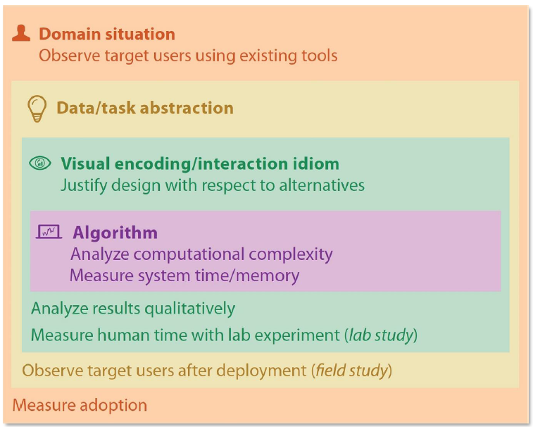
Validation: domain situation
Assessment:
Target user: high school STEM student. They know electrical power is expressed in Watt, they know the prefix M, they know a windmill produces electrical energy.
Key questions:
“how is offshore currently distributed over the different continents?”
“what continents are in the lead of renewable wind integration”
“can you find attribute X of the biggest windfarm in Europe?
“which region is has the highest growth in installed wind capacity in the period 2020-2023?"
Validation:
no interviews
try to imagine yourself in the role of high school student
maybe ask a student? (not yet decided)
questions are good
Notes:
Mishkat

Slide 12

Validation: data/task abstraction
Assessment:
the data is hiërarchical, fine data can easily be bucketed into aggregate categories
questions 1 and 2 are ‘analyse’ questions.
question 3 combines both the ‘search’ with the ‘query’ aspect of a viz.
at first both location & power will be unknown
→ then you order by power → then you locate → then you query
question 4 is a ‘search’ by filtering on time and status (lookup) and a ‘query’ to compare the rates between regions
Validation:
this layer is the least ‘clear’ to us
we’d like to discuss how to assess data/abstraction better and avoid jumping from domain to idiom selection?
don’t focus too much on this abstraction, don’t formalize it too much
Notes:
Mishkat

Slide 13
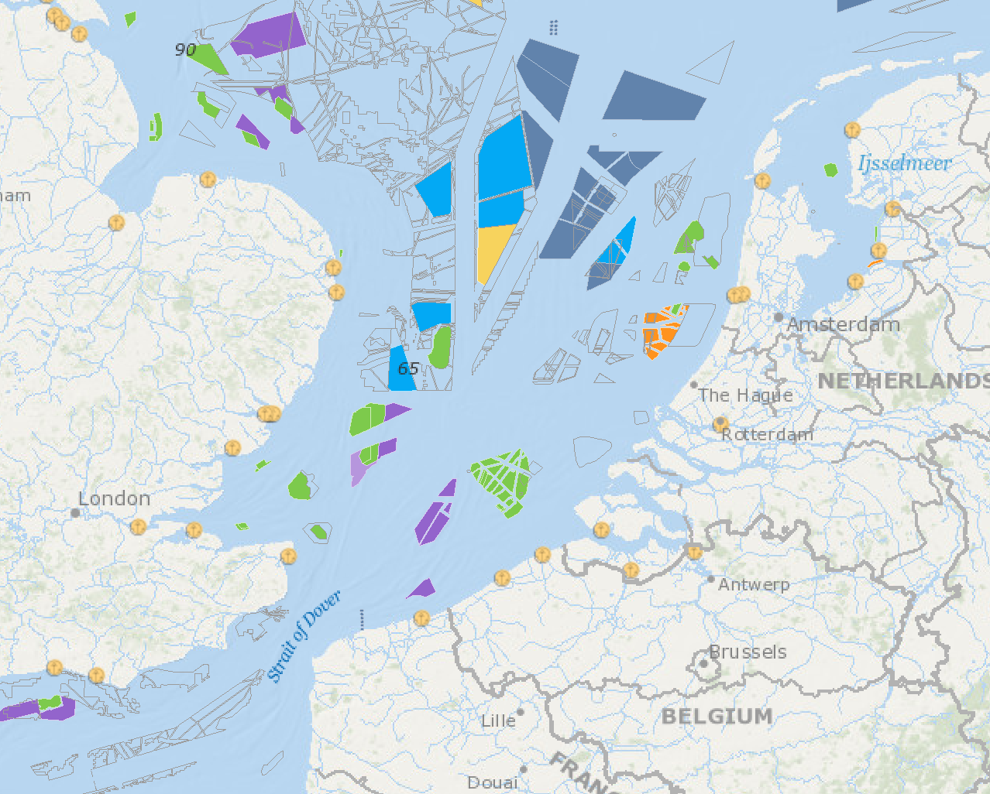
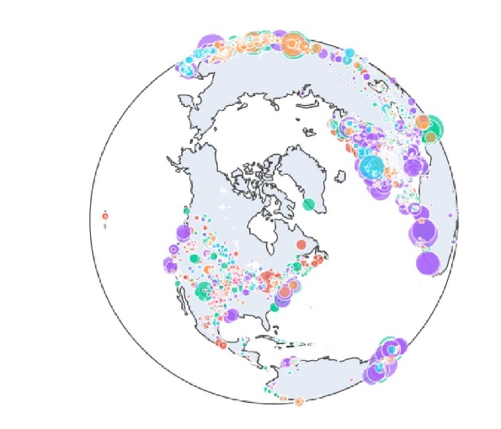

Validation: idiom selection (i)
Assessment:
filters:
alphabetical combo boxes for categorical values
multiple values can be selected
slider for time scale
BANs* for 1st hiërarchical level (e.g. continent) showing immediatly some summary statistics
geographical distribution:
map with circles
size as channel for power rating
hue as a channel for status? map sensible comments to sensible status (e.g. red = cancelled)
no choropleth – offshore concessions are often very small
when zooming out, the area quickly becomes too small to use hue as channel
top stations:
horizontal bar chart
position as channel for power rating + maybe second channel (luminance?)
or map status to color here as well? this way we get more information from the bar chart
having interaction between different viz elements is a +
don’t overload size channel with 2nd (like saturation) it won’t be necessary
*“Big Aggregate Numbers” or “Big Actionable Numbers”
Notes:
Mishkat
maybe add the idioms that we have discarded as unfit

Slide 14
Validation: idiom selection (ii)
Assessment:
query:
pop-up table with relevant attributes
Validation:
mockup (see next slide)
mid-term feedback ;-)
*“Big Aggregate Numbers” or “Big Actionable Numbers”
Notes:
Mishkat

Slide 15
Validation: algorithm
Assessment:
dataset is static, non-streaming
query and summary statistics can be pre-computed
map viz will be slowest section → try alternative framework(s) if first does not suffice
Validation:
benchmark it
*“Big Aggregate Numbers” or “Big Actionable Numbers”
Notes:
Mishkat

Slide 16
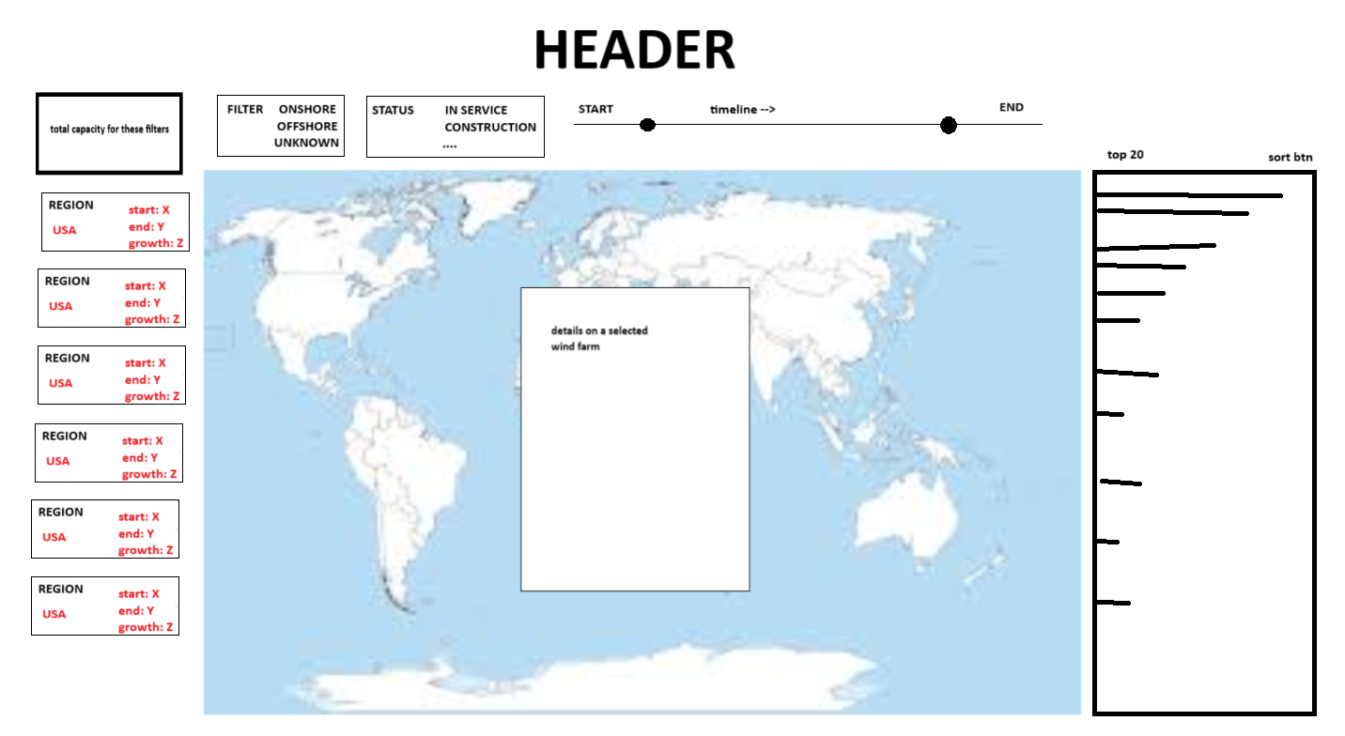
Mockups (3 iterations)
additional filters
(sub)total
Filters on top
BAN on the left that also filter the main viz
Main viz on the middle
Horizontal bar chart on the right
Popup in the middle (query result)
map updates / zooms according to filters
look for test users and see if they can answer the test questions
even if the response time is slow, if the accuracy is high that is great
use the ideq+ survey
clicking a farm in map or rank shows all attributes
ranking updates according to filters
BAN serving as level 1 filter
Notes:
Jorrit

Slide 17

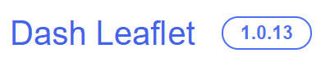









Tech stack overview
Product
Collaboration
https://github.com/jorritvm/infovis
source
Notes:
Jorrit

Slide 18
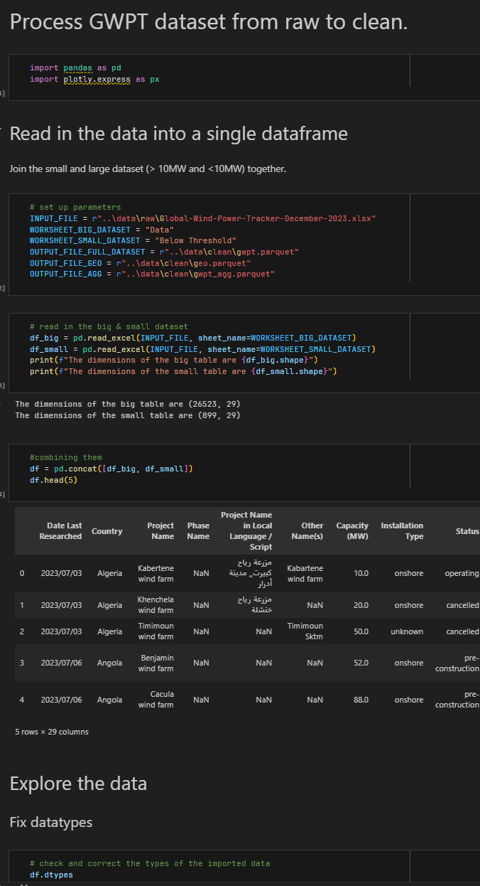
ETL using jupyter & pandas
Apart from NA handling in non-key attributes the ETL is finished.
source

Slide 19
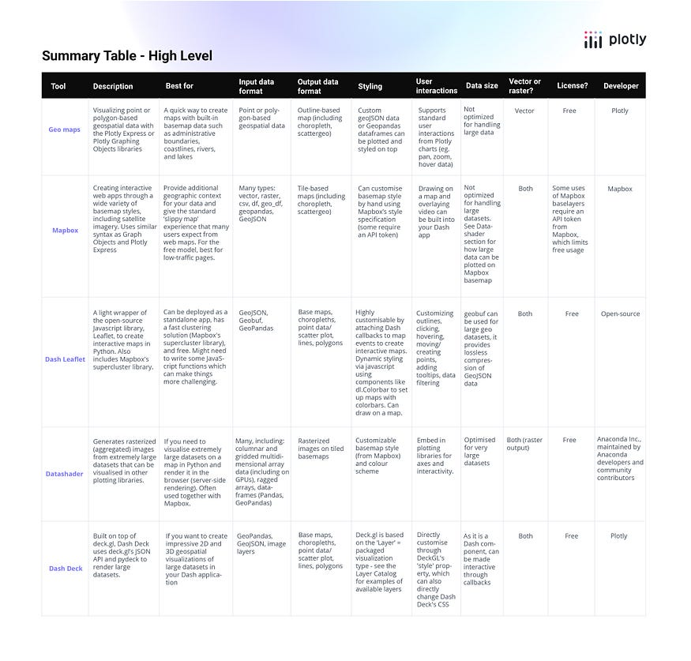
Map viz tech
Initial tests to analyse:
interoperability with dash
performance
native semantic zooming
More evaluation will be needed!
Notes:
Jorrit

Slide 20
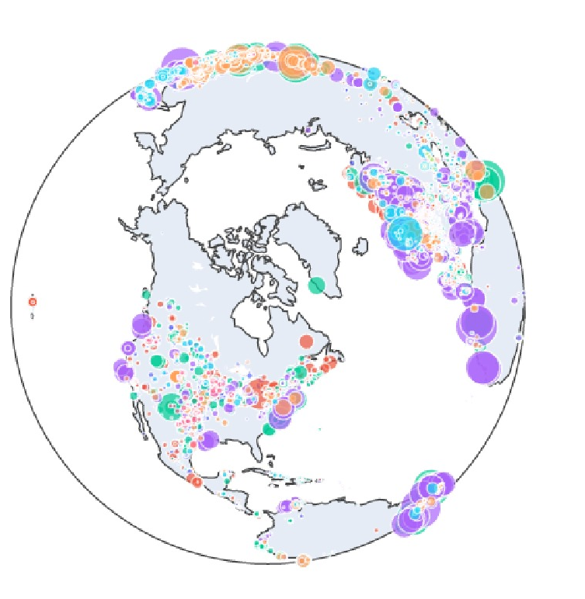
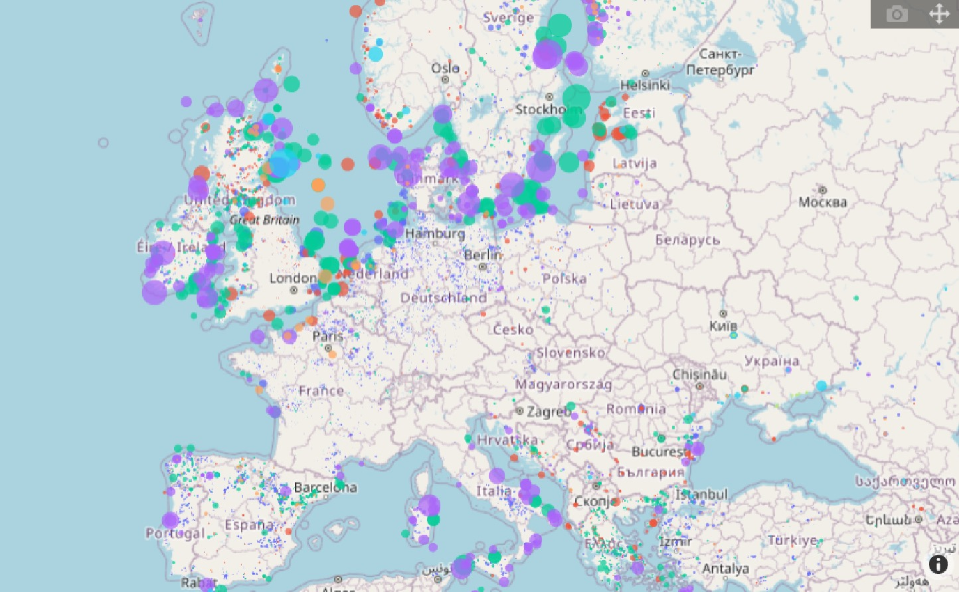
Map viz tech tests
don’t do 3D,
do the 2D!

Slide 21
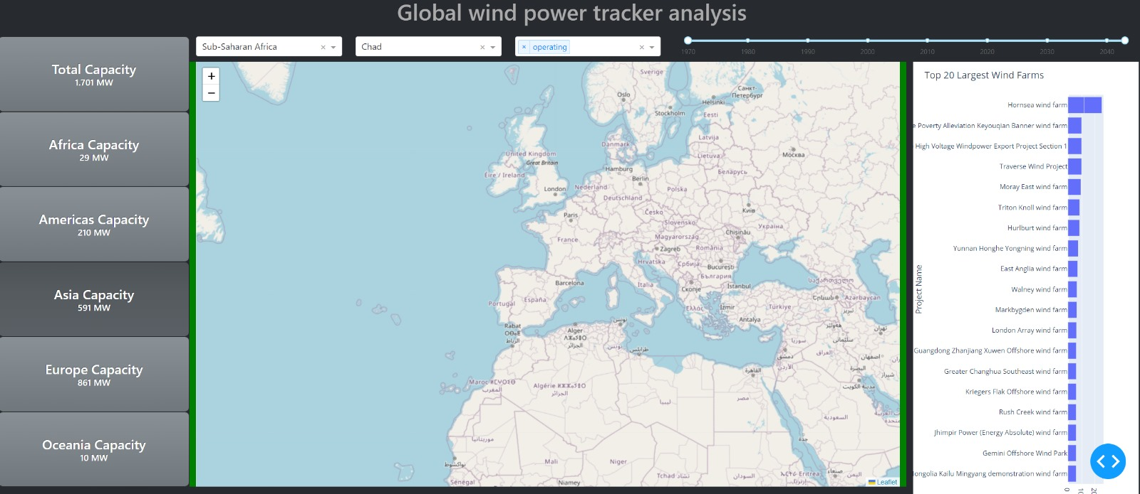
Fast prototyping using dash
blue for sea is definitly ok, will not interfere with hard colors for status
do not remove the wind farm ‘id’ – avoid too much indirection!
Notes:
Jorrit
question of light vs dark mode?
usefull to identify usefull bootstrap components (e.g. button rather than card)

Slide 22
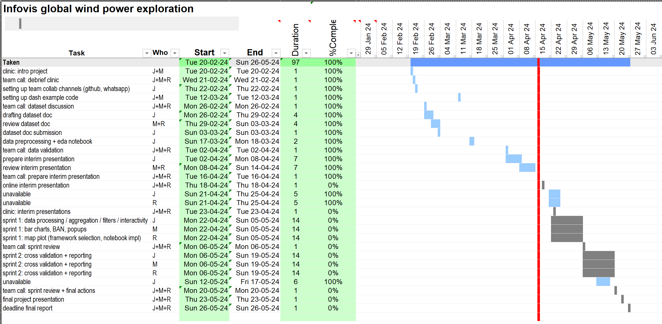
Project plan
Notes:
Jorrit
about the 23/4 clinic? is it required that we are present as well? (e.g. daytime students have to follow the other’s presentation)

